Slide 1
Evolutionary Algorithm
Unit # 6

Slide 2
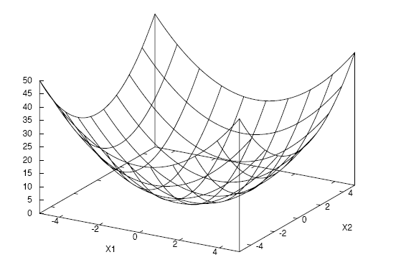
Assignment # 1 (Function 1)
f(x, y) = x² + y²
-5 < x, y < 5

Slide 3
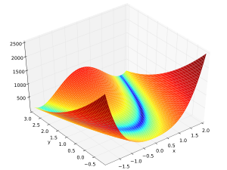
Assignment # 1 (Function 2)
f(x, y) = 100 * (x² – y)² + (1 – x)²
-2 < x < 2, -1 < y < 3

Slide 4
A Typical Evolutionary Algorithm Cycle
Step 1: Initialize the population randomly or with potentially good solutions.
Step 2: Compute the fitness of each individual in the population.
Step 3: Select parents using a selection procedure.
Step 4: Create offspring by crossover and mutation operators.
Step 5: Compute the fitness of the new offspring.
Step 6: Select members of population to die using a selection procedure.
Step 7: Go to Step 2 until termination criteria are met.

Slide 5
Assignment Implementation Details
Let’s pick the population size to 10. So initialize 10 individuals of the form (x, y) randomly.
Compute their fitness.
Using one of the parent selection scheme, generate 10 offspring (using crossover and mutation). For mutation, you can use +/- 0.25. Remember that mutation is not applied to each gene. So you need to make it probabilistic as well.
Compute fitness of the offspring.

Slide 6
Assignment Implementation Details (Cont’d)
Now you got 10 parents and 10 offspring (20 individuals.
Using one of the survival selection scheme, pick 10 individuals that survive to the next generation. Discard the remaining individuals.
Store best survived individual’s fitness and average fitness of the whole survived individual.

Slide 7
Assignment Implementation Details (Cont’d)
Suppose you run this process for 40 generations. You will have recorded the following observations.
Generation # | Best Fitness | Average Fitness
1
2
..
..
..
40

Slide 8
Average Best-So-Far
You need to repeat this exercise (for a single combination of parent and survival selection schemes) 10 times).
Each run will start with new randomly initialized population.
Generation # | Run # 1 BSF | Run # 2 BSF | .. | .. | Run # 10 BSF | Average BSF
1
2
..
..
..
40

Slide 9
Average Average-Fitness
You need to repeat this exercise (for a single combination of parent and survival selection schemes 10 times) for average fitness values.
Each run will start with new randomly initialized population.
Generation # | Run # 1 Avg. Fit. | Run # 2 Avg. Fit. | .. | .. | Run # 10 Avg. Fit. | Average Avg. Fit.
1
2
..
..
..
40

Slide 10
Assignment Implementation Details (Cont’d)
Once you have gotten (a) average best-so-far values and average average-fitness, you need to plot the values against generation # (separate graphs).
The scheme described in the previous slides will be repeated for each combination of parent and survival selections, i.e.,
FPS and Truncation
RBS and Truncation
Binary Tournament and Truncation
FPS and Binary Tournament
RBS and Binary Tournament
Binary Tournament and Binary Tournament

Slide 11
Performance Indicator
Best-so-far (BSF) - We record the best solution found by the algorithm thus far for each generation in every run.
Average-of-current-population (ACP) - We record the average solution in each generation in every run.
Worst-of-current-population (WCP) - We record the worst solution in each generation in every run.

Slide 12
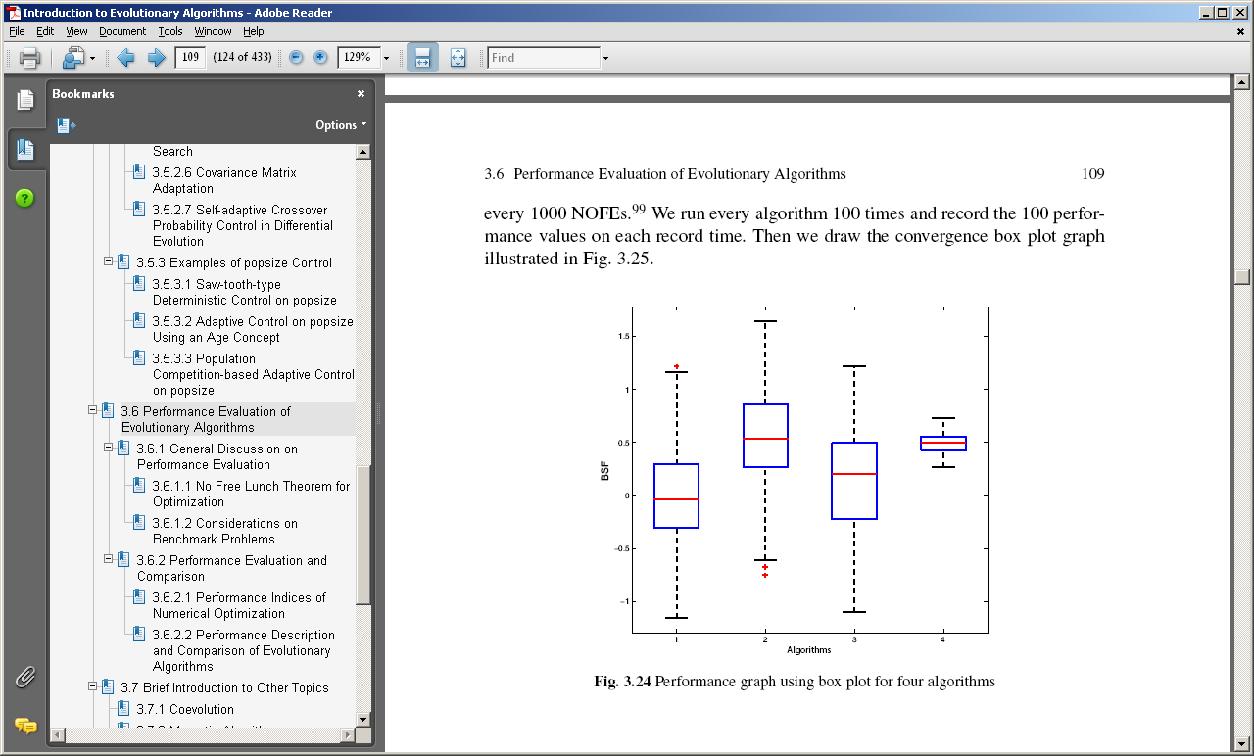
Performance Graph using Boxplot

Slide 13
Performance Description and Comparison of EA
Statistical visualization uses graphs to describe and compare EAs, which is very illustrative.
The box plot is the most useful way to graphically illustrate the performance of EAs.

Slide 14
Performance Description and Comparison of EA (Cont’d)
Descriptive Statistics - Graphs are easy to understand, but sometimes the difference between different algorithms is small. Then we need specific numbers to describe and compare the performance.
The most often used descriptive statistics are mean and variance (or standard deviation).

Slide 15
Performance Description and Comparison of EA (Cont’d)
Statistical Inference - Sometimes descriptive statistics is also not strong enough to differentiate between two results, in which case we need statistical inference.
Statistical inference includes parameter estimation, hypothesis testing, and many other techniques.
Here we focus on hypothesis testing to verify whether the difference between two results is statistically significant.

Slide 16
Evolution of Bipedal Walk for RoboCup

Slide 17
Evolution of Bipedal Walk for RoboCup (Cont’d)

Slide 18
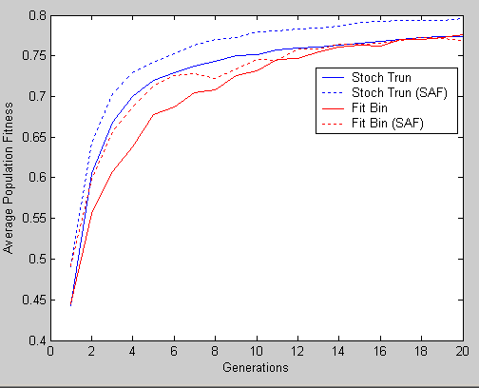
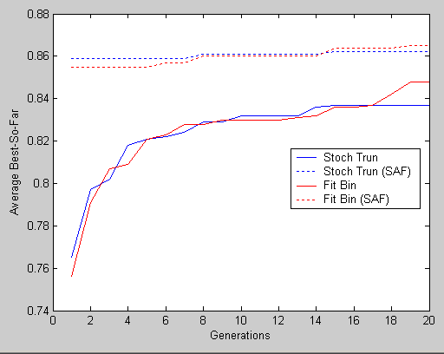
Random vs. Heuristic based Initialization

Slide 19
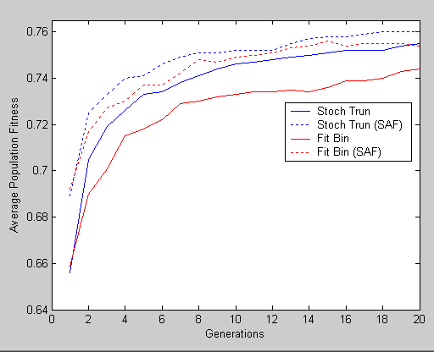
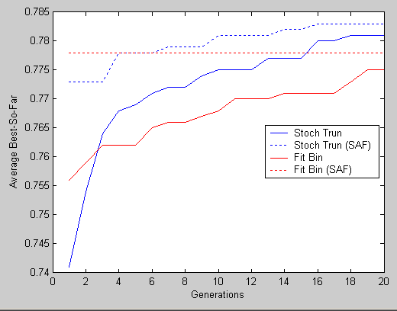
Random vs. Heuristic based Initialization (Cont’d)

